Slide 1
CND212: Digital Testing and Verification

Slide 2
SystemVerilog Arrays

Slide 3
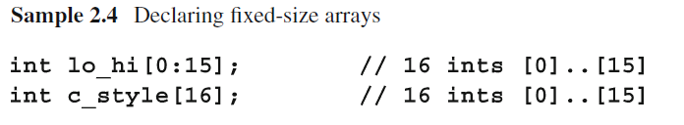
SystemVerilog Enhancement - Arrays
SystemVerilog enhances the use of arrays to include the following:
Compact Declaration
Packed Arrays
Dynamic Arrays
Associative Arrays
SystemVerilog compact array declaration is similar to C’s style

Slide 4
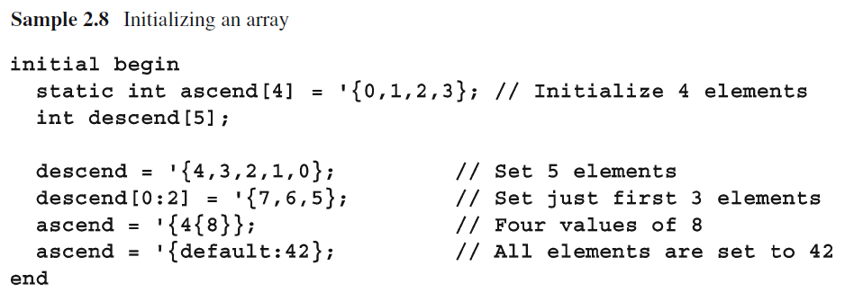
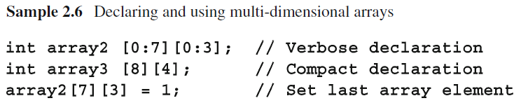
Fixed Arrays – Declaration & Initialization
The Array size is set during compile time
Declaring and initializing fixed arrays
Declaring muti-dimensional fixed arrays

Slide 5
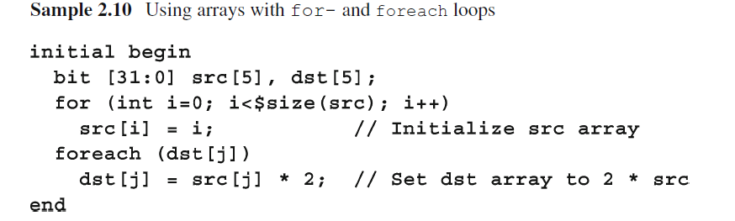
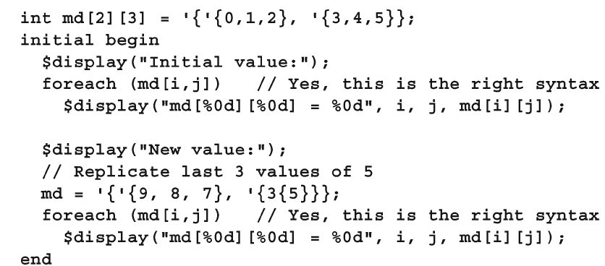
Fixed Arrays Operations
Using for and foreach

Slide 6
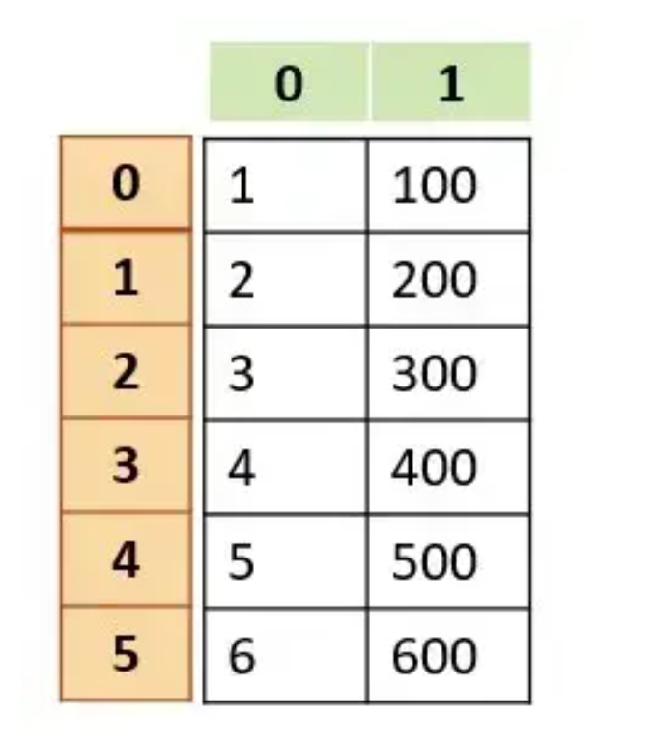
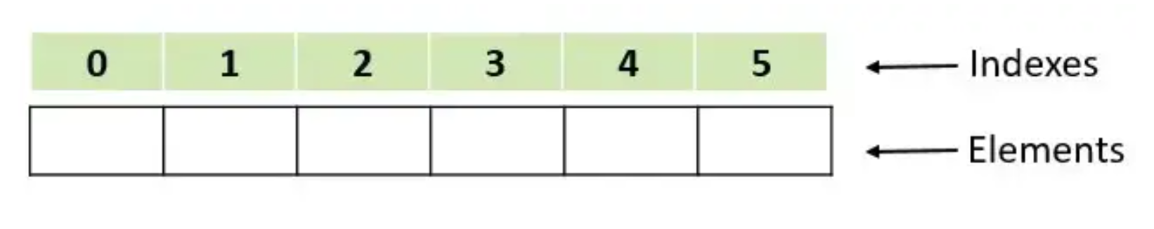
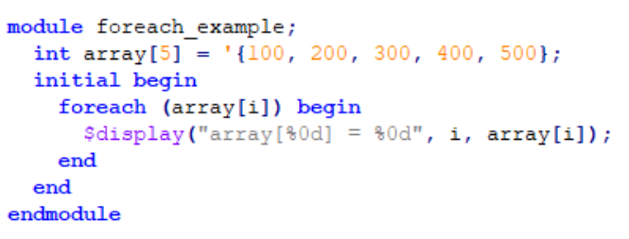
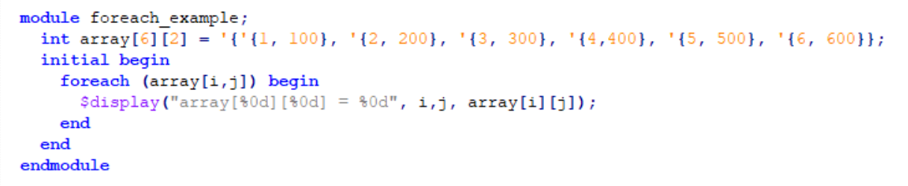
Fixed Arrays Operations
1-D Array
2-D Array
Indices

Slide 7
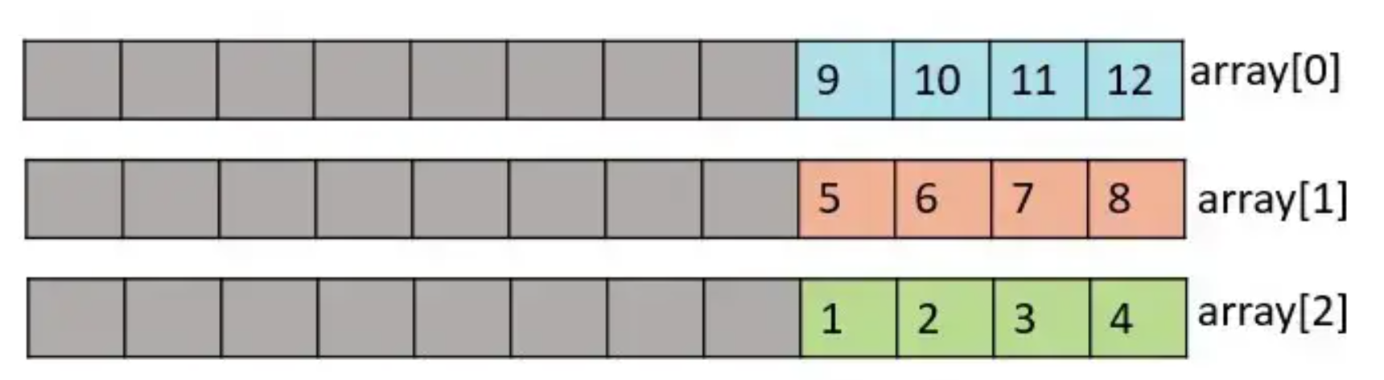
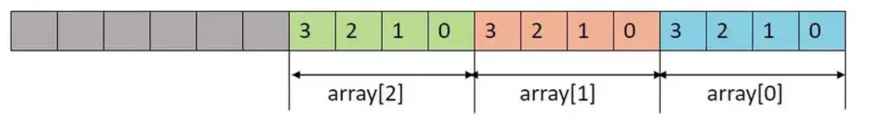
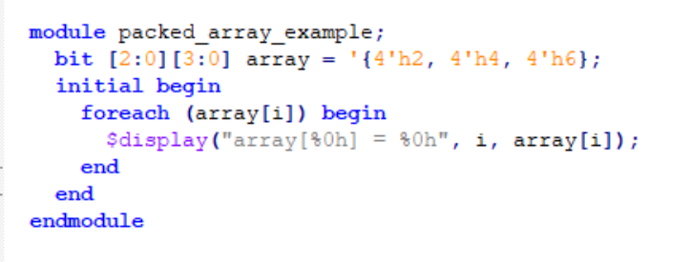
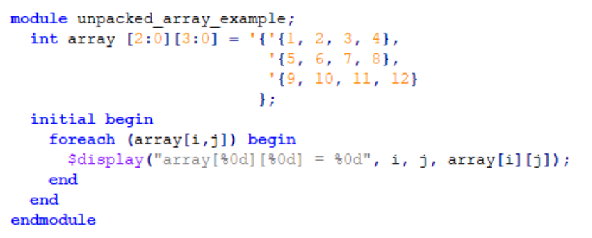
Packed vs. Unpacked Arrays
Packed:
Dimension is written before the variable name
Unpacked:
Dimension is written after the variable name

Slide 8
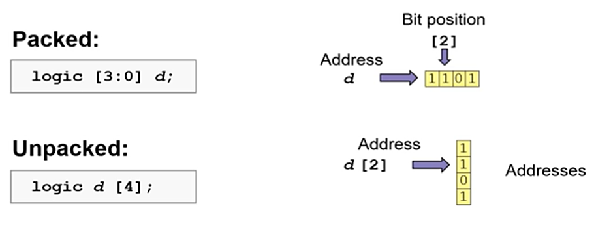
Packed vs. Unpacked Arrays

Slide 9
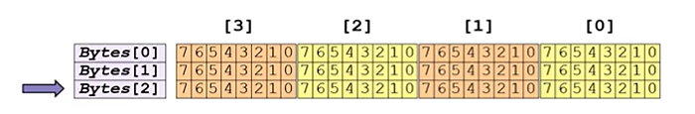
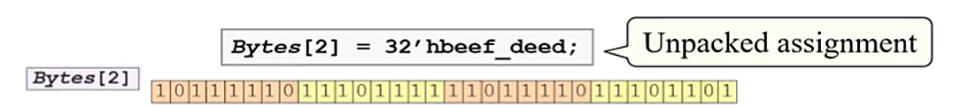
Array Example-1
Notes:
Byte[1][0] = byte[2][1]

Slide 10
Array Example-1

Slide 11
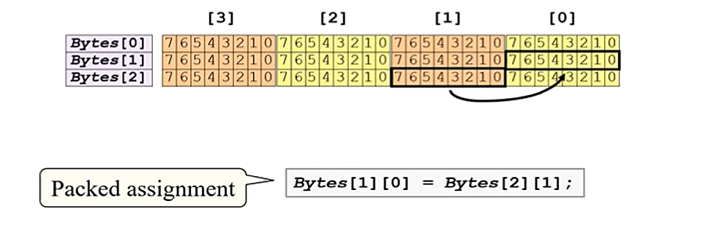
Array Example-2

Slide 12
Array Example-2

Slide 13
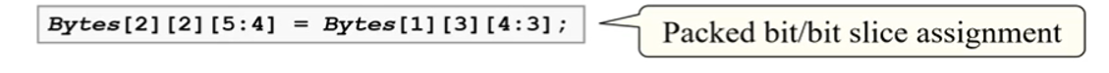
Array Example-3

Slide 14
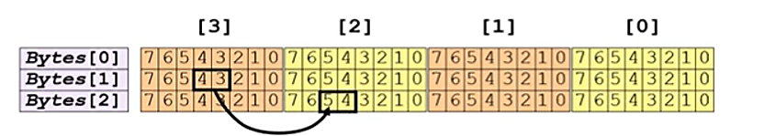
Array Example-3

Slide 15
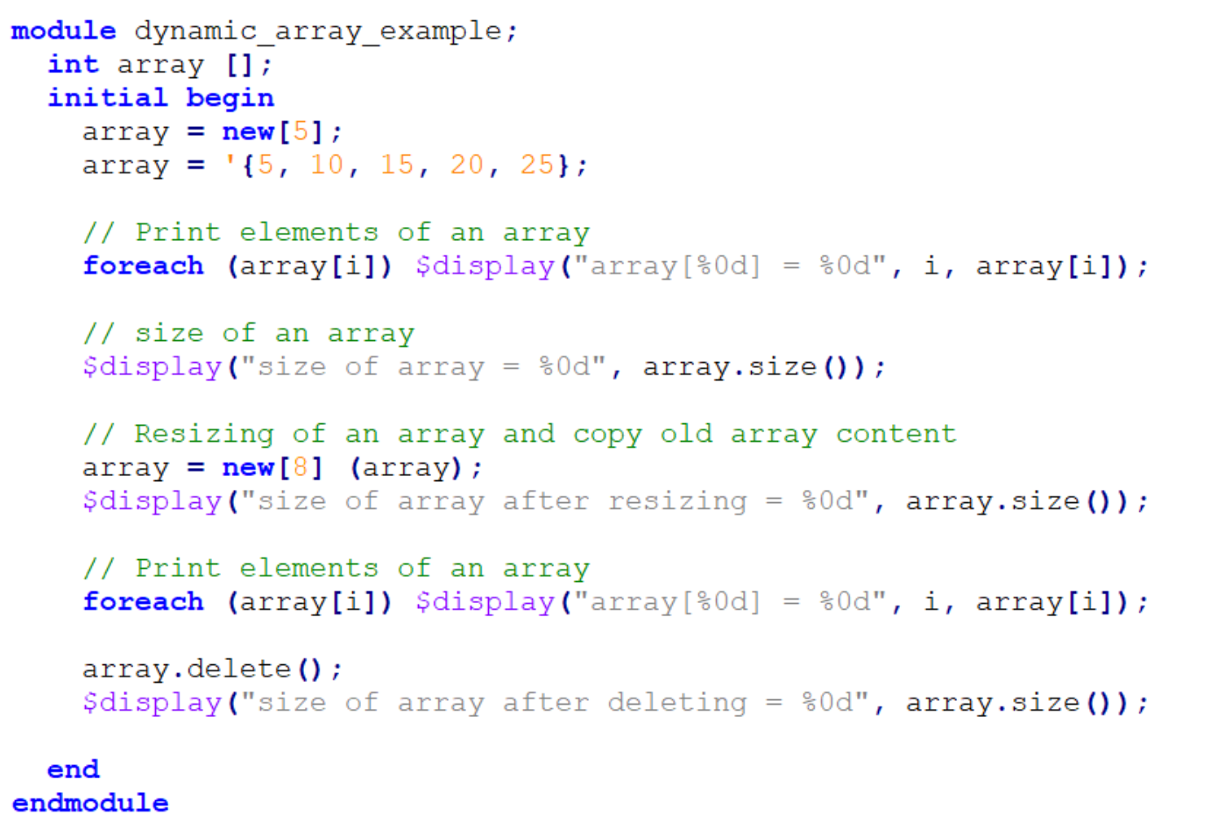
Dynamic Arrays
Dynamic arrays can be allocated and resized during run-time simulation.
A dynamic array is initially empty, and new space is allocated during simulation time using new[ ] constructor
Dynamic array size() method
Returns the current size of a dynamic array.
Dynamic array delete() method
Deletes array elements.

Slide 16
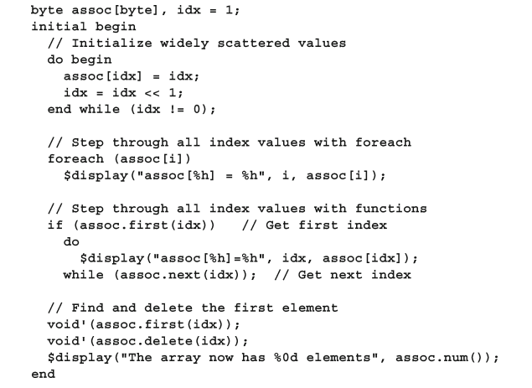
Associative Arrays
Useful for allocating large sparse arrays without compromising memory space
Memory is allocated only when adding an element
Array index can be of any type, e.g. string or class.
An associative array implements a lookup table of the elements of its declared type.
The data type to be used as an index serves as the lookup key and imposes an ordering

Slide 17
Associative Array-Methods
Function | Description
num (); | Returns the number of entries in the associative array
size (); | Also returns the number of entries, if empty 0 is returned
delete ( [input index] ); | index when specified deletes the entry at that index, else the whole array is deleted
exists (input index); | Checks whether an element exists at specified index; returns 1 if it does, else 0
first (ref index); | Assigns to the given index variable the value of the first index; returns 0 for empty array
last (ref index); | Assigns to given index variable the value of the last index; returns 0 for empty array
next (ref index); | Finds the smallest index whose value is greater than the given index
prev (ref index); | Finds the largest index whose value is smaller than the given index

Slide 18
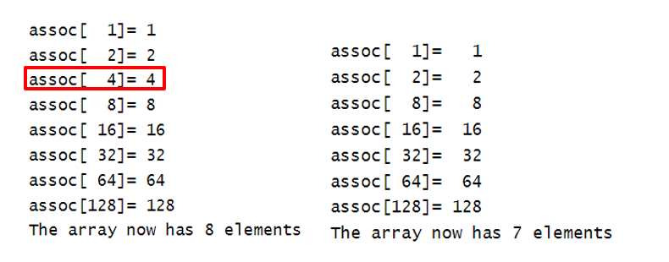
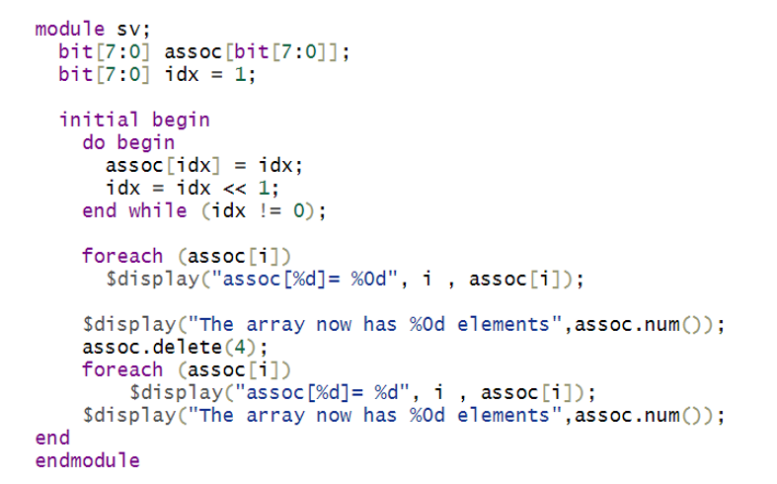
Associative Array-Example

Slide 19
Structs (Packed vs. Unpacked)

Slide 20
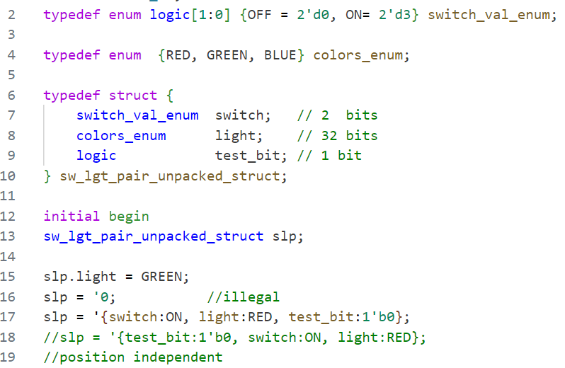

Unpacked struct Example
Each member has a distinct memory location
Each member can be assigned a value independently
Entire set of struct members can be assigned via member name (position independent)
Operation on the entire unpacked structure is illegal

Slide 21
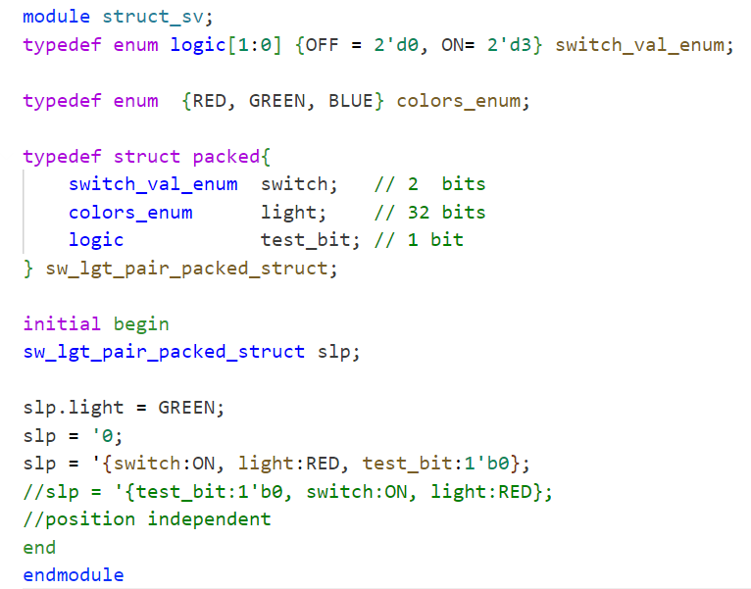


Packed struct Example
Can be accessed separately or as a single word
Entire set of struct members can be assigned via member name (position independent)
Similar to unpacked struct
Operation on the entire packed structure is legal
Multiple views are possible and allowed
Additional memory/runtime overhead to track both views

Slide 22
Queues

Slide 23
Queues
data_type queue_name[$];
Combines the best of a linked list and arrays
Elements can be added anywhere in a queue
A queue is declared with word subscripts containing a dollar sign: [$]
The elements of a queue are numbered from 0 to $.
Queue literals only have curly braces, and are missing the initial apostrophe of array literals

Slide 24
Queues - Methods
Function | Description
insert (<index>,<item>) | Inserts an item at a specified index.
- delete(<index>) - delete | -> Deletes an item at a specified index -> Deletes all elements in the queue.
size() | If the queue is not empty, return the number of items in the queue. Otherwise, it returns 0.
push_back(<item>) | Inserts an item at the end of the queue.
pop_back() | Returns and removes the last item of the queue.
push_front(<item>) | Inserts an item at the front of the queue.
pop_front() | Returns and removes the first item of the queue.
shuffle() | Shuffles items in the queue

Slide 25
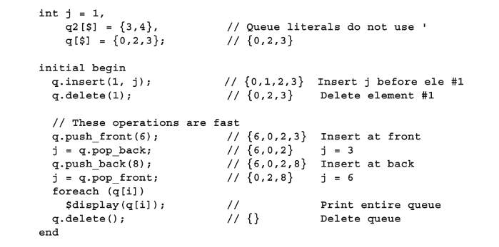
Queues - Methods

Slide 26
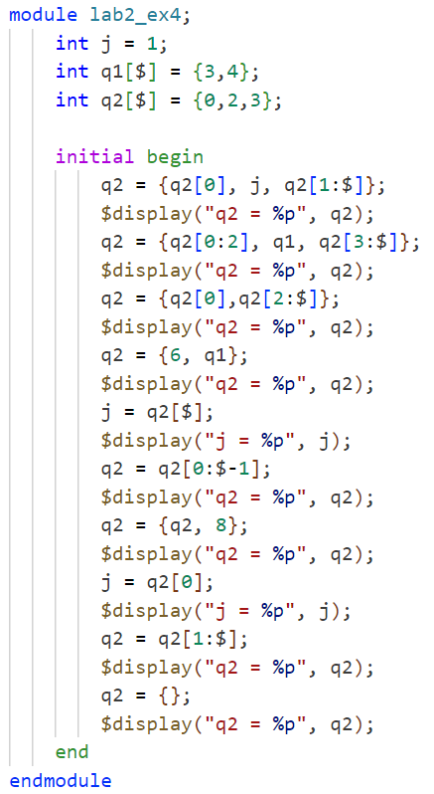
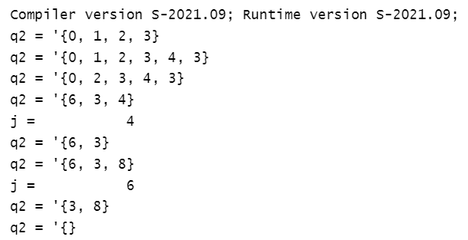
Queues – Example

Slide 27
Lab 2: (~90 mins)

Slide 28
Lab 2 Exercise 1
Implement a memory model using a multidimensional array with 64 locations and 32 bits entry size, where:
The array contents are initialized randomly and then printed.
The last 3 bytes of each entry are accessed and then complemented.
Store the entries at the same location and print the modified array.

Slide 29
Lab 2 Exercise 2
Design a sequence detector to detect 011
Create a testbench to test your DUT
Driver: create an input queue to drive your DUT
bit input_queue[$]= {0, 0, 1, 1, 0, 0, 0, 1, 1, 0};
Monitor: create a queue to capture output
bit detect_design_queue[$];
Scoreboard: compare the output queue with the queue from the golden model
bit detect_GoldenModel_queue[$]= {0, 0, 0, 1, 0, 0, 0, 0, 1, 0};

Slide 30
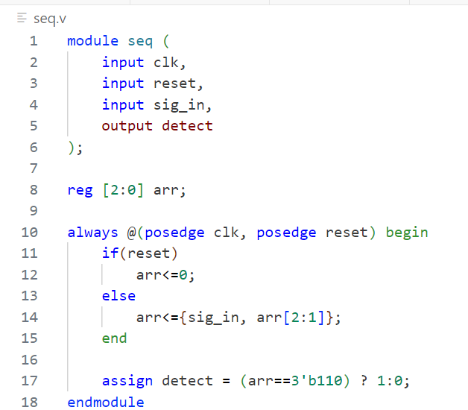
Lab 2 Exercise 2

